Slide 1


Text and Natural Language Processing
20
PART IV · DEEP LEARNING AND MODERN AI
CHAPTER 20 · WEEK 12
Data Science — From Foundations to Intelligent Systems
LECTURER
Dr. Mustafa Hameed
THE ISLAMIA UNIVERSITY OF BAHAWALPUR
Bahawalpur, Pakistan
Department of Information Technology · BSIT · Fall 2026
Notes:
Chapter 20: Text and Natural Language Processing. Part 4 — Deep Learning and Modern AI. Week 12: Time series; text and NLP. Handout pages 129–133.

Slide 2

Where this chapter sits
THE COURSE
PART I
PART II
PART III
PART IV
PART V
PART VI
1
2
3
4
5
6
7
8
9
10
11
12
13
14
15
16
17
18
19
20
21
22
23
24
25
26
27
28
29
30
31
32
Text and Natural Language Processing
BUILDS ON
USED LATER IN
Ch 4 The Mathematical Toolkit
Ch 21 Generative AI and Large Language Models
Ch 13 Supervised Learning II: Classification
Ch 18 Deep Architectures
Data Science · Chapter 20 · Text and Natural Language Processing
Handout p. 129 2
Notes:
Place the chapter. Before you start: Chapter 4 (cosine similarity — the standard text metric), Chapter 13 (naive Bayes) and Chapter 18 (embeddings and attention).

Slide 3

What you will be able to do
LEARNING OUTCOMES
By the end of this chapter you will be able to:
1
Apply the standard text preprocessing pipeline and justify each step.
2
Compute TF-IDF and explain what it measures.
3
Distinguish sparse bag-of-words representations from dense embeddings.
4
Build a text classifier and evaluate it appropriately.
5
Interpret topic model output and state its limitations.
Data Science · Chapter 20 · Text and Natural Language Processing
Handout p. 129 3
Notes:
Read these out: they are the chapter's contract with the room. Each click adds one.

Slide 4

Vocabulary for this chapter
KEY TERMS
corpus
token
tokenisation
stop words
stemming
lemmatisation
bag of words
n-gram
term frequency
inverse document frequency
TF-IDF
sparse vs dense
word embedding
contextual embedding
topic modelling
named entity recognition
Each term is defined where it first matters — not here.
Data Science · Chapter 20 · Text and Natural Language Processing
Handout p. 129 4
Notes:
Do not define these now; they arrive one at a time. This slide is for the students' notes. Terms: corpus; token; tokenisation; stop words; stemming; lemmatisation; bag of words; n-gram; term frequency; inverse document frequency; TF-IDF; sparse vs dense; word embedding; contextual embedding; topic modelling; named entity recognition.

Slide 5
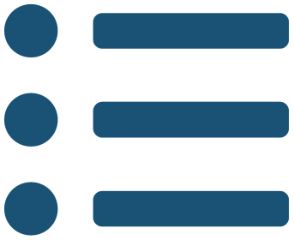
In this chapter
IN THIS CHAPTER
20.1
Turning Words into Numbers
p. 129 ›
20.2
Bag of Words and TF-IDF
p. 130 ›
20.3
From Sparse to Dense
p. 130 ›
20.4
Topic Modelling
p. 131 ›
Data Science · Chapter 20 · Text and Natural Language Processing
Handout pp. 129–133 5
Notes:
The route through the chapter. Each row is a link: click it to jump to that section in the slide show.

Slide 6
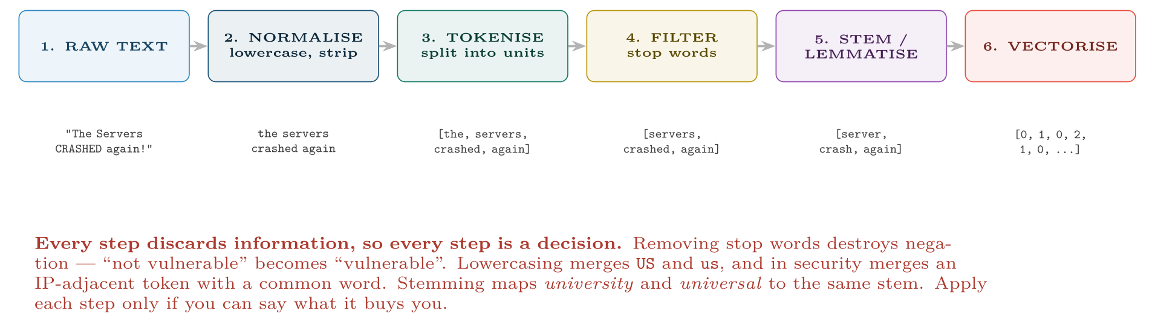
The classical text preprocessing pipeline
FIGURE 20.1
Modern transformer models skip most of steps 2–5, using subword tokenisation directly — but the classical pipeline is still what you want for fast, explainable, low-resource classifiers.
Data Science · Chapter 20 · Text and Natural Language Processing
§20.1 · Handout p. 129 6
Notes:
Every model in this book consumes an n × p matrix of numbers (Figure 4.1). Text is not that. The entire first half of natural language processing is the problem of producing that matrix without throwing away the meaning.
Figure 20.1 (handout p. 129): The classical text preprocessing pipeline. Modern transformer models skip most of steps 2–5, using subword tokenisation directly — but the classical pipeline is still what you want for fast, explainable, low-resource classifiers.

Slide 7
Bag of Words and TF-IDF
SECTION 2 OF 4
20.2
20.1 Turning Words into Numbers
20.2 Bag of Words and TF-IDF
20.3 From Sparse to Dense
20.4 Topic Modelling
Data Science · Chapter 20
Handout §20.2 7
Notes:
Pause. Name the question this section answers.

Slide 8

Bag of Words
DEFINITION
Represent each document as a vector of word counts over a fixed vocabulary. Word order is discarded entirely — hence “bag”. Crude, and surprisingly effective for classification.
Data Science · Chapter 20 · Text and Natural Language Processing
§20.2 · Handout p. 130 8
Notes:
Read the box aloud, then ask for an example from the room before moving on.

Slide 9

TF-IDF
DEFINITION
A term scores highly when it is frequent in this document and rare across the corpus — which is a good working definition of “distinctive”.
Data Science · Chapter 20 · Text and Natural Language Processing
§20.2 · Handout p. 130 9
Notes:
Read the box aloud, then ask for an example from the room before moving on.

Slide 10

Computing TF-IDF
WORKED EXAMPLE
A corpus of N = 1000 support tickets. Consider one ticket of 100 words.
Term | count | tf | docs containing | idf
the | 8 | 0.08 | 1000 | log(1000/1000)=0
server | 4 | 0.04 | 300 | log(1000/300)=1.20
kerberos | 2 | 0.02 | 12 | log(1000/12)=4.42
TF-IDF scores:
• the: 0.08 × 0 = 0 — appears everywhere, so it distinguishes nothing. Note that IDF has removed it automatically, without any stop-word list.
• server: 0.04 × 1.20 = 0.048
• kerberos: 0.02 × 4.42 = 0.088
Data Science · Chapter 20 · Text and Natural Language Processing
§20.2 · Handout p. 130 10
Notes:
Each click adds one step of the working. Ask for the next number before you reveal it.

Slide 11
Computing TF-IDF (continued)
WORKED EXAMPLE
The result that matters: kerberos outranks server despite appearing half as often, because it is rare across the corpus and therefore tells you far more about which ticket this is. That is the whole idea, and it is why TF-IDF — whose inverse-document-frequency term dates from 1972 — remains a strong baseline half a century on.
Data Science · Chapter 20 · Text and Natural Language Processing
§20.2 · Handout p. 130 11
Notes:
Each click adds one step of the working. Ask for the next number before you reveal it.

Slide 12
From Sparse to Dense
SECTION 3 OF 4
20.3
20.1 Turning Words into Numbers
20.2 Bag of Words and TF-IDF
20.3 From Sparse to Dense
20.4 Topic Modelling
Data Science · Chapter 20
Handout §20.3 12
Notes:
Pause. Name the question this section answers.

Slide 13

The Weakness of Bag of Words
WATCH OUT
In a TF-IDF space, server, host and machine are three completely unrelated dimensions — as unrelated as server and banana. The representation has no notion of meaning, only of spelling. A model trained on documents saying “server” will learn nothing applicable to documents saying “host”.
Data Science · Chapter 20 · Text and Natural Language Processing
§20.3 · Handout p. 130 13
Notes:
Read the box aloud, then ask for an example from the room before moving on.

Slide 14
Word Embedding
DEFINITION
A dense vector of a few hundred dimensions, learned so that words appearing in similar contexts get similar vectors. Meaning becomes geometry: cosine similarity between embeddings measures semantic relatedness.
Data Science · Chapter 20 · Text and Natural Language Processing
§20.3 · Handout p. 130 14
Notes:
Read the box aloud, then ask for an example from the room before moving on.

Slide 15
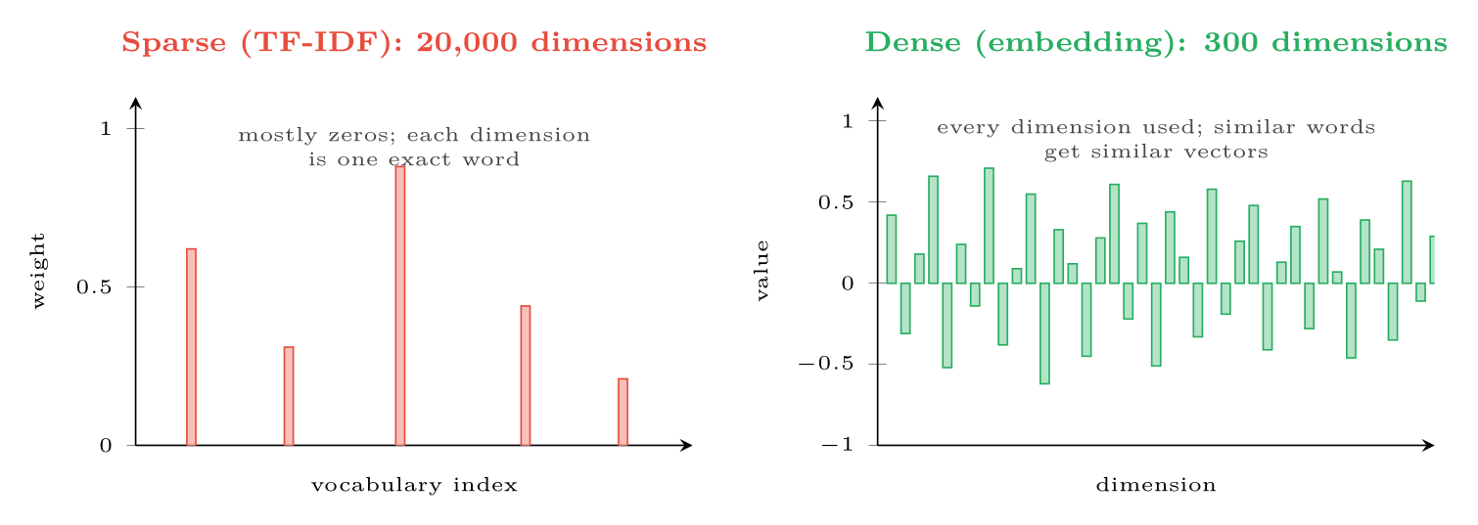
Sparse versus dense text representations
FIGURE 20.2
TF-IDF is interpretable but has no concept of synonymy; embeddings capture meaning but no single dimension means anything you can name.
Data Science · Chapter 20 · Text and Natural Language Processing
§20.3 · Handout p. 130 15
Notes:
Figure 20.2 (handout p. 131): Sparse versus dense text representations. TF-IDF is interpretable but has no concept of synonymy; embeddings capture meaning but no single dimension means anything you can name.

Slide 16

Static versus Contextual Embeddings
CONCEPT
Early embeddings (word2vec, GloVe) give each word one fixed vector, so bank in “river bank” and “bank account” share a vector — a real limitation. Transformer models (Chapter 18) produce contextual embeddings: the vector for a word depends on the sentence it is in. This is the main practical advance behind modern NLP, and it is what Chapter 21 builds on.
Data Science · Chapter 20 · Text and Natural Language Processing
§20.3 · Handout p. 130 16
Notes:
Read the box aloud, then ask for an example from the room before moving on.

Slide 17
Topic Modelling
SECTION 4 OF 4
20.4
20.1 Turning Words into Numbers
20.2 Bag of Words and TF-IDF
20.3 From Sparse to Dense
20.4 Topic Modelling
Data Science · Chapter 20
Handout §20.4 17
Notes:
Pause. Name the question this section answers.

Slide 18
Topic Modelling
DEFINITION
An unsupervised method (Chapter 16 applied to text) that discovers recurring themes in a corpus. Each topic is a distribution over words; each document is a mixture of topics. Latent Dirichlet Allocation (LDA) is the classical method.
Data Science · Chapter 20 · Text and Natural Language Processing
§20.4 · Handout p. 131 18
Notes:
Read the box aloud, then ask for an example from the room before moving on.

Slide 19
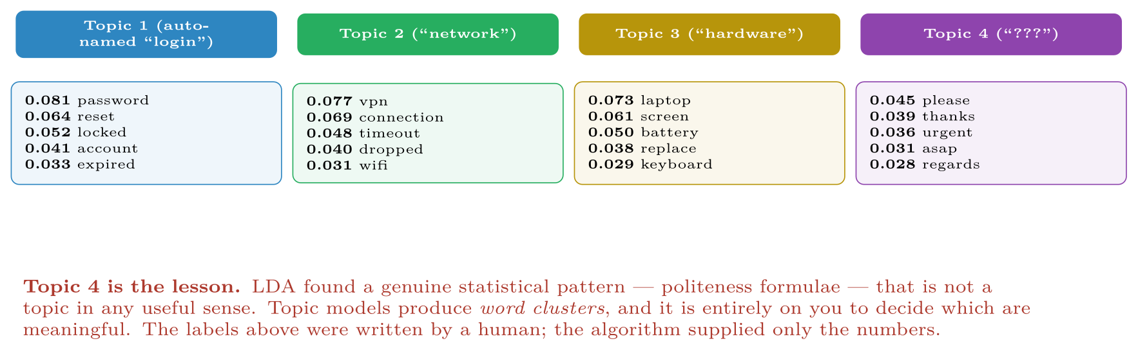
Output of a four-topic LDA on IT support tickets
FIGURE 20.3
Three topics are useful; the fourth is a statistical artefact. Never present topic model output without human inspection.
Data Science · Chapter 20 · Text and Natural Language Processing
§20.4 · Handout p. 131 19
Notes:
Figure 20.3 (handout p. 131): Output of a four-topic LDA on IT support tickets. Three topics are useful; the fourth is a statistical artefact. Never present topic model output without human inspection.

Slide 20





Four lenses: Text Analytics
FOUR LENSES
LEARNING ANALYTICS
PROJECT MANAGEMENT
Analyse free-text reflections, forum posts and module feedback.
Classify support tickets and requirement documents automatically, and mine retrospective notes for recurring themes.
INTERNET OF THINGS
CYBERSECURITY
Text appears where you might not expect it: device logs, error strings and maintenance notes.
Phishing and spam detection is the classic application: naive Bayes on TF-IDF remains fast enough for mail-gateway volumes and is still competitive.
Data Science · Chapter 20 · Text and Natural Language Processing
Handout p. 133 20
Notes:
The same method, four domains. Each of the next four slides opens one lens in full.

Slide 21

Learning Analytics: Text Analytics
FOUR LENSES
LEARNING ANALYTICS
Project Management
Analyse free-text reflections, forum posts and module feedback. Sentiment and topic trends across a semester reveal problems that numeric engagement data misses entirely — a cohort can be clicking dutifully and telling you in prose that they are lost. Two cautions: student writing is identifiable even after anonymisation, and automated sentiment scoring of individuals is an ethical decision, not a technical one (Chapter 28).
Internet of Things
Cybersecurity
Data Science · Chapter 20 · Text and Natural Language Processing
Handout p. 133 21
Notes:
Learning Analytics. Analyse free-text reflections, forum posts and module feedback. Sentiment and topic trends across a semester reveal problems that numeric engagement data misses entirely — a cohort can be clicking dutifully and telling you in prose that they are lost. Two cautions: student writing is identifiable even after anonymisation, and automated sentiment scoring of individuals is an ethical decision, not a technical one (Chapter 28).

Slide 22

Project Management: Text Analytics
FOUR LENSES
PROJECT MANAGEMENT
Learning Analytics
Classify support tickets and requirement documents automatically, and mine retrospective notes for recurring themes. TF-IDF plus logistic regression is usually sufficient and takes an afternoon; it is also explainable, which matters when the classifier is routing work to people. Topic modelling over several years of retrospectives is a genuinely useful way to find problems the organisation keeps re-discovering.
Internet of Things
Cybersecurity
Data Science · Chapter 20 · Text and Natural Language Processing
Handout p. 133 22
Notes:
Project Management. Classify support tickets and requirement documents automatically, and mine retrospective notes for recurring themes. TF-IDF plus logistic regression is usually sufficient and takes an afternoon; it is also explainable, which matters when the classifier is routing work to people. Topic modelling over several years of retrospectives is a genuinely useful way to find problems the organisation keeps re-discovering.

Slide 23

Internet of Things: Text Analytics
FOUR LENSES
INTERNET OF THINGS
Learning Analytics
Text appears where you might not expect it: device logs, error strings and maintenance notes. Treating log lines as text — tokenising, then clustering templates — turns an unmanageable stream into a manageable set of message types, and a new template appearing is itself an anomaly signal. Engineers’ free-text maintenance records are often the only ground-truth labels available for predictive maintenance (Chapter 25).
Project Management
Cybersecurity
Data Science · Chapter 20 · Text and Natural Language Processing
Handout p. 133 23
Notes:
Internet of Things. Text appears where you might not expect it: device logs, error strings and maintenance notes. Treating log lines as text — tokenising, then clustering templates — turns an unmanageable stream into a manageable set of message types, and a new template appearing is itself an anomaly signal. Engineers’ free-text maintenance records are often the only ground-truth labels available for predictive maintenance (Chapter 25).

Slide 24

Cybersecurity: Text Analytics
FOUR LENSES
CYBERSECURITY
Learning Analytics
Phishing and spam detection is the classic application: naive Bayes on TF-IDF remains fast enough for mail-gateway volumes and is still competitive. Beyond that, text classification applies to malware strings, command-line arguments and DNS names. Note the adversarial character: spammers deliberately misspell, insert homoglyphs and pad with innocuous text specifically to defeat tokenisation — so preprocessing choices here are a security control, not a convenience.
Project Management
Internet of Things
Data Science · Chapter 20 · Text and Natural Language Processing
Handout p. 133 24
Notes:
Cybersecurity. Phishing and spam detection is the classic application: naive Bayes on TF-IDF remains fast enough for mail-gateway volumes and is still competitive. Beyond that, text classification applies to malware strings, command-line arguments and DNS names. Note the adversarial character: spammers deliberately misspell, insert homoglyphs and pad with innocuous text specifically to defeat tokenisation — so preprocessing choices here are a security control, not a convenience.

Slide 25

Try it yourself: TF-IDF Classifier and Topics
TRY IT YOURSELF
WHAT YOU WILL DO
1. A strong, explainable text classifier in four lines
2. WHY did it decide that? the great virtue of this approach
3. Topic modelling: ALWAYS read the topics before believing them
THIS WEEK'S LAB
WHAT YOU WILL RUN
Week 12: Decompose & walk-forward; TF-IDF classifier
1 listing, 33 lines of Python
Data Science · Chapter 20 · Text and Natural Language Processing
§20.4 · Handout p. 131 25
Notes:
Say what the room will have at the end of the lab, then let them start. Circulate rather than lecture.

Slide 26
TF-IDF Classifier and Topics
LAB · STEP 1 OF 4
Set-up
Python
1
2
3
4
5
6
from sklearn.feature_extraction.text import TfidfVectorizer
from sklearn.linear_model import LogisticRegression
from sklearn.pipeline import make_pipeline
from sklearn.decomposition import LatentDirichletAllocation
from sklearn.metrics import classification_report
import numpy as np
Data Science · Chapter 20 · Text and Natural Language Processing
§20.4 · Handout p. 131 26
Notes:
Step 1: Set-up. Read the code aloud; ask what each line would print before running it.

Slide 27
TF-IDF Classifier and Topics
LAB · STEP 2 OF 4
A strong, explainable text classifier in four lines
Python
7
8
9
10
11
12
13
14
15
16
# --- 1. a strong, explainable text classifier in four lines -----------
clf = make_pipeline(
TfidfVectorizer(ngram_range=(1, 2), # unigrams + bigrams: "not vulnerable"
min_df=3, # ignore terms in fewer than 3 docs
max_df=0.85, # ignore terms in >85% of docs
sublinear_tf=True),
LogisticRegression(max_iter=1000, class_weight="balanced"),
).fit(train_texts, train_labels)
print(classification_report(test_labels, clf.predict(test_texts), digits=3))
Data Science · Chapter 20 · Text and Natural Language Processing
§20.4 · Handout p. 131 27
Notes:
Step 2: A strong, explainable text classifier in four lines. Read the code aloud; ask what each line would print before running it.

Slide 28
TF-IDF Classifier and Topics
LAB · STEP 3 OF 4
WHY did it decide that? the great virtue of this approach
Python
17
18
19
20
21
22
# --- 2. WHY did it decide that? the great virtue of this approach -----
vec, lr = clf.named_steps["tfidfvectorizer"], clf.named_steps["logisticregression"]
terms = np.array(vec.get_feature_names_out())
top = lr.coef_[0].argsort()
print("most indicative of the positive class:", terms[top[-12:]][::-1])
print("most indicative of the negative class:", terms[top[:12]])
Data Science · Chapter 20 · Text and Natural Language Processing
§20.4 · Handout p. 131 28
Notes:
Step 3: WHY did it decide that? the great virtue of this approach. Read the code aloud; ask what each line would print before running it.

Slide 29
TF-IDF Classifier and Topics
LAB · STEP 4 OF 4
Topic modelling: ALWAYS read the topics before believing them
Python
23
24
25
26
27
28
29
30
# --- 3. topic modelling: ALWAYS read the topics before believing them -
counts = TfidfVectorizer(max_df=0.85, min_df=5).fit(all_texts)
lda = LatentDirichletAllocation(n_components=6, random_state=0)
lda.fit(counts.transform(all_texts))
vocab = counts.get_feature_names_out()
for k, comp in enumerate(lda.components_):
print(f"topic {k}:", ", ".join(vocab[i] for i in comp.argsort()[-8:][::-1]))
# Inspect each one. Expect at least one to be an artefact like Topic 4 above.
Data Science · Chapter 20 · Text and Natural Language Processing
§20.4 · Handout p. 131 29
Notes:
Step 4: Topic modelling: ALWAYS read the topics before believing them. Read the code aloud; ask what each line would print before running it.

Slide 30

A word appears in every document of a corpus. What is its IDF, and what does that do to its TF-IDF score?
CHECKPOINT 1 OF 3
Discuss with the person next to you, then advance.
Data Science · Chapter 20 · Text and Natural Language Processing
Handout p. 133 · answers in Appendix D 30
Notes:
Ask the room. Do not advance until someone commits to an answer.

Slide 31

A word appears in every document of a corpus. What is its IDF, and what does that do to its TF-IDF score?
CHECKPOINT 1 OF 3 · ANSWER
log(N/N) = log 1 = 0, so its TF-IDF score is zero regardless of how often it appears. IDF removes uninformative words automatically.
Data Science · Chapter 20 · Text and Natural Language Processing
Handout p. 133 · answers in Appendix D 31
Notes:
Answer (Appendix D): log(N/N) = log 1 = 0, so its TF-IDF score is zero regardless of how often it appears. IDF removes uninformative words automatically.

Slide 32
Give a concrete example where removing stop words would reverse the meaning of a document.
CHECKPOINT 2 OF 3
Discuss with the person next to you, then advance.
Data Science · Chapter 20 · Text and Natural Language Processing
Handout p. 133 · answers in Appendix D 32
Notes:
Ask the room. Do not advance until someone commits to an answer.

Slide 33
Give a concrete example where removing stop words would reverse the meaning of a document.
CHECKPOINT 2 OF 3 · ANSWER
“The system is not vulnerable” becomes “system vulnerable” once not is removed as a stop word — an exact reversal. Bigrams or a curated stop-word list avoid this.
Data Science · Chapter 20 · Text and Natural Language Processing
Handout p. 133 · answers in Appendix D 33
Notes:
Answer (Appendix D): “The system is not vulnerable” becomes “system vulnerable” once not is removed as a stop word — an exact reversal. Bigrams or a curated stop-word list avoid this.

Slide 34
Why does TF-IDF treat “server” and “host” as completely unrelated, and what representation fixes it?
CHECKPOINT 3 OF 3
Discuss with the person next to you, then advance.
Data Science · Chapter 20 · Text and Natural Language Processing
Handout p. 133 · answers in Appendix D 34
Notes:
Ask the room. Do not advance until someone commits to an answer.

Slide 35
Why does TF-IDF treat “server” and “host” as completely unrelated, and what representation fixes it?
CHECKPOINT 3 OF 3 · ANSWER
Because bag-of-words dimensions correspond to exact strings, and “server” and “host” are simply different strings. Dense embeddings, which place words used in similar contexts near each other, fix it.
Data Science · Chapter 20 · Text and Natural Language Processing
Handout p. 133 · answers in Appendix D 35
Notes:
Answer (Appendix D): Because bag-of-words dimensions correspond to exact strings, and “server” and “host” are simply different strings. Dense embeddings, which place words used in similar contexts near each other, fix it.

Slide 36

What to take away
CHAPTER SUMMARY
1
Text must become a numeric matrix; every preprocessing step trades information for tractability and must be justified.
2
Bag of words discards order; TF-IDF weights terms by frequency in the document and rarity in the corpus, and downweights common words automatically.
3
Sparse representations are interpretable but blind to synonymy; dense embeddings capture meaning as geometry but individual dimensions mean nothing.
4
Contextual embeddings from transformers give a word a different vector in each sentence, which is the main modern advance.
5
Topic models find word clusters, not topics. Human inspection is mandatory.
6
TF-IDF plus logistic regression remains a fast, strong, explainable baseline — try it before anything larger.
Data Science · Chapter 20 · Text and Natural Language Processing
Handout p. 133 36
Notes:
Ask the room to say each takeaway before you reveal it.

Slide 37

Quick check 1 of 2
REVIEW · MULTIPLE CHOICE
A term appearing in 1 of 1000 documents has an IDF of roughly:
A
0
B
1
C
3
D
7
Data Science · Chapter 20 · Text and Natural Language Processing
Handout p. 133 37
Notes:
Take a show of hands for each option before discussing. (The handout does not print MCQ answers.)

Slide 38
Quick check 2 of 2
REVIEW · MULTIPLE CHOICE
Which representation captures that “laptop” and “notebook” are related?
A
bag of words
B
TF-IDF
C
word embeddings
D
n-grams
Data Science · Chapter 20 · Text and Natural Language Processing
Handout p. 133 38
Notes:
Take a show of hands for each option before discussing. (The handout does not print MCQ answers.)

Slide 39
For your notebook
REVIEW QUESTIONS
SHORT
Explain in your own words what TF-IDF measures and why the IDF term makes stop-word removal partly redundant.
SHORT
Give two reasons why bigrams often improve a text classifier.
SHORT
Why must topic model output be inspected by a human before it is reported?
APPLIED
Design a pipeline to classify 40,000 IT support tickets into eight categories. State your preprocessing choices with a justification for each, your representation, your model, and your evaluation metric — noting that the categories are heavily imbalanced.
APPLIED
A phishing classifier trained on TF-IDF starts failing. Investigation shows attackers now write “pa55word” and “inv0ice”. Explain why the model failed, and propose two changes that would make it more robust.
Data Science · Chapter 20 · Text and Natural Language Processing
Handout p. 133 39
Notes:
Set these for independent study. Model answers are not printed in the handout.

Slide 40
End of Chapter 20
20
NEXT
READ
Chapter 21 — Generative AI and Large Language Models
Handout Chapter 20, pages 129–133
THIS WEEK'S LAB
ASSESSMENT
Decompose & walk-forward; TF-IDF classifier
Assignment 2 due
Data Science · Chapter 20 · Text and Natural Language Processing
40
Notes:
Close. NEXT: Chapter 21 — Generative AI and Large Language Models. READ: Handout Chapter 20, pages 129–133. THIS WEEK'S LAB: Decompose & walk-forward; TF-IDF classifier. ASSESSMENT: Assignment 2 due.

